Slide 1
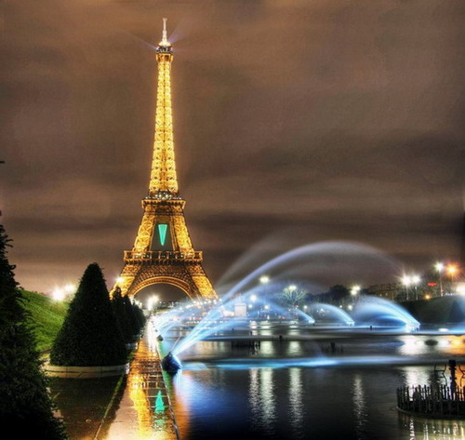
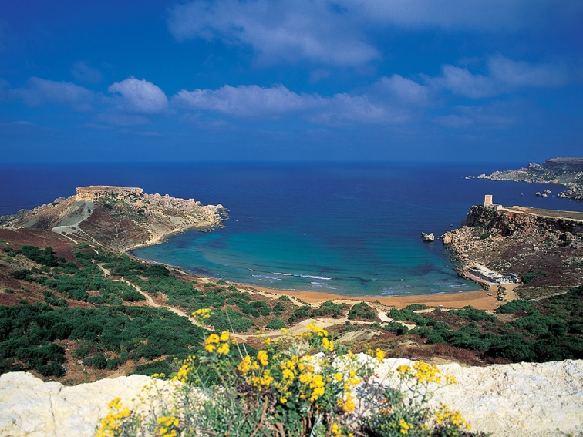
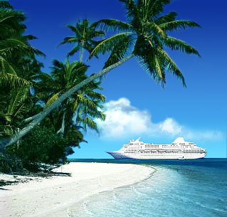
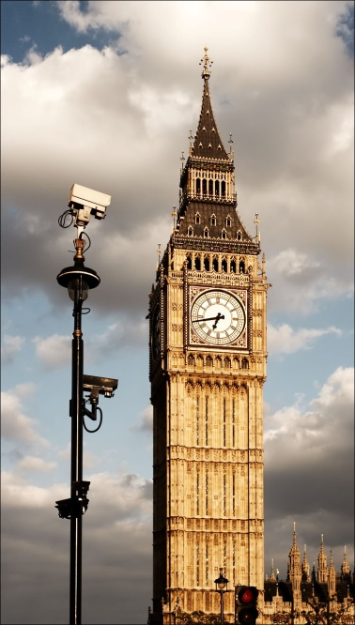
Travelling

Slide 2
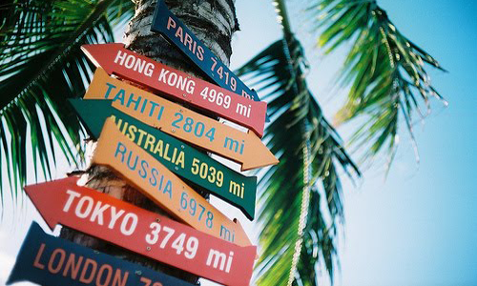
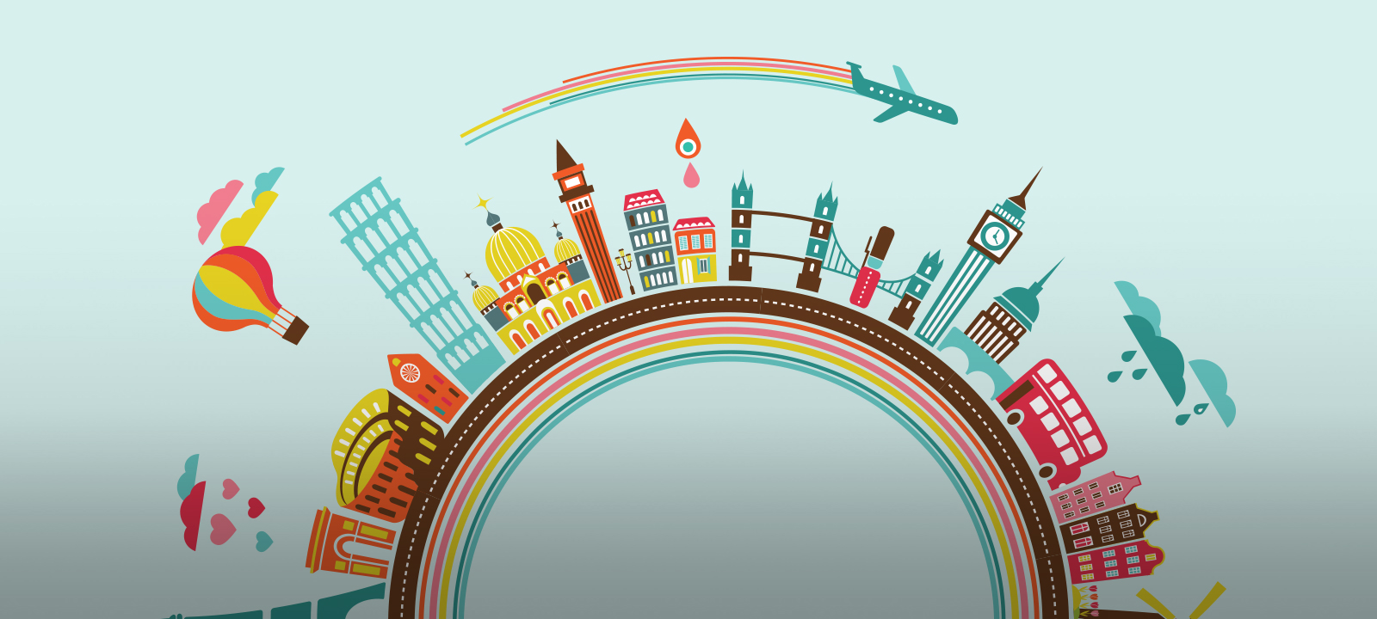
Do you like to travel?
Is it your hobby?
Where did you go?
Did you like your journey?
Why people travel?
What things we need for travelling?

Slide 3
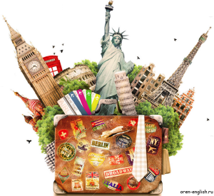
East or West home is best.
There is no place like home.
Custom is the second nature.
Fortune favors the bold.

Slide 4
Travelling by plane
Hiking and hitch-hiking
Travelling by car
Travelling by ship
Travelling by train
Travelling by bicycle

Slide 5
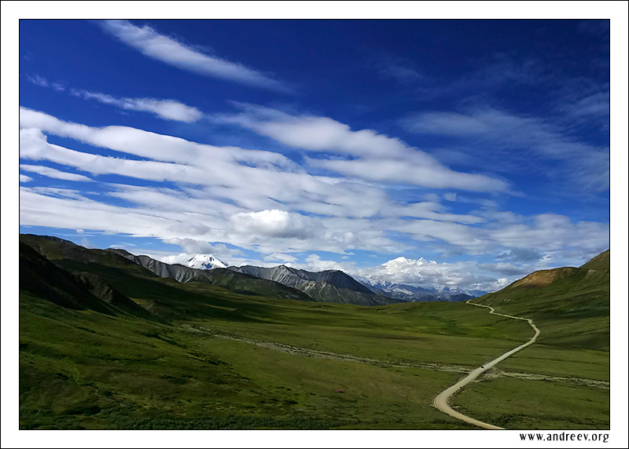
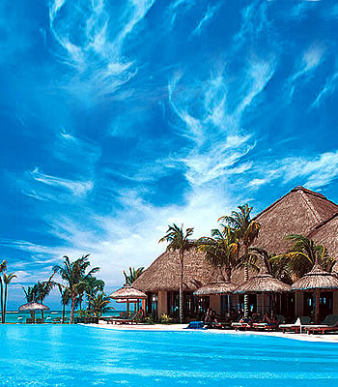
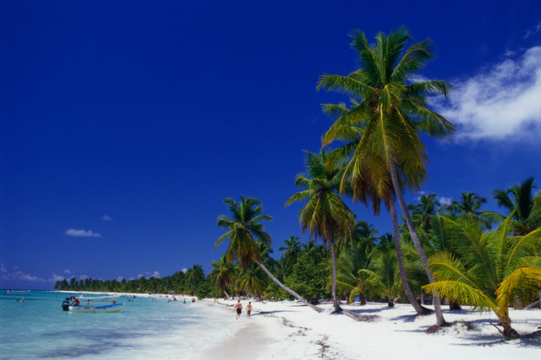
Almost all people are fond of travelling. It is very interesting to see new places, another towns and countries. People may travel either for pleasure or on business. There are various methods of travelling.

Slide 6
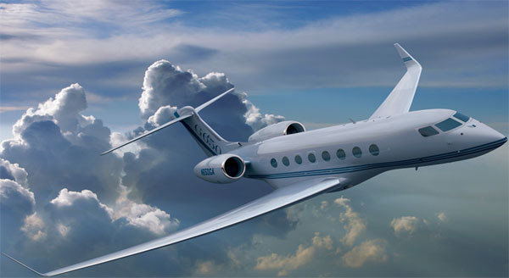
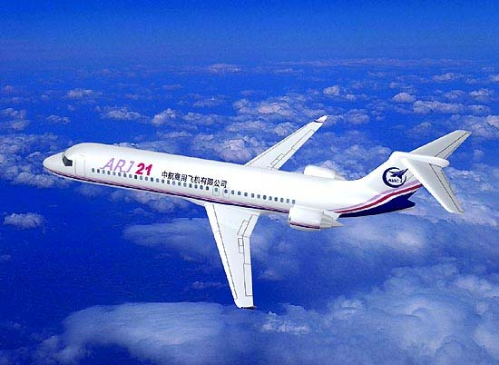
travelling by plane
For me there is nothing like travel by air; it is more comfortable, more convenient and, of course, far quicker than any other method. There is none of the dust and dirt of a railway or car journey, none of the trouble of changing from train to steamer and then to another train.

Slide 7
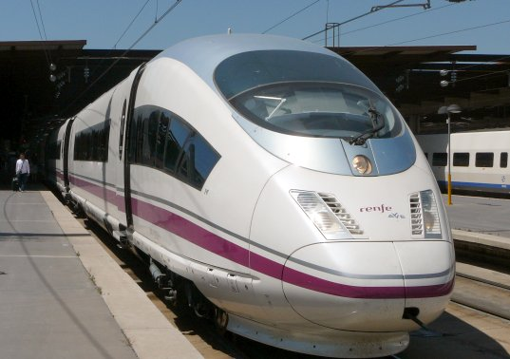
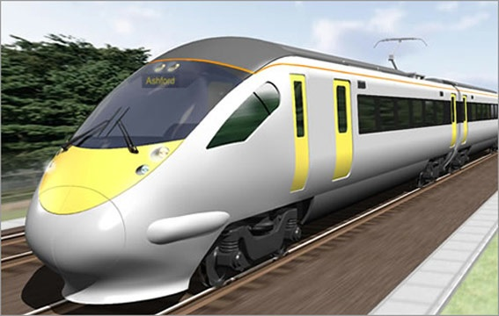
travelling by train
With a train you have speed, comfort and pleasure combined. From the comfortable seat of a railway carriage you have a splendid view of the whole country-side. If you are hungry, you can have a meal in the dining-car; and if a journey is a long one you can have a wonderful bed in a sleeper.

Slide 8
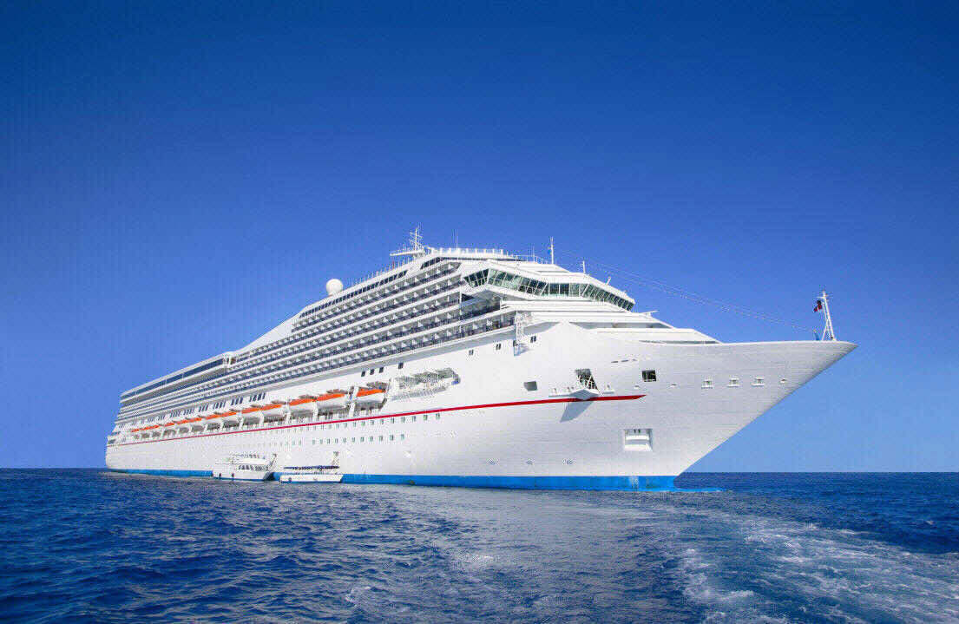
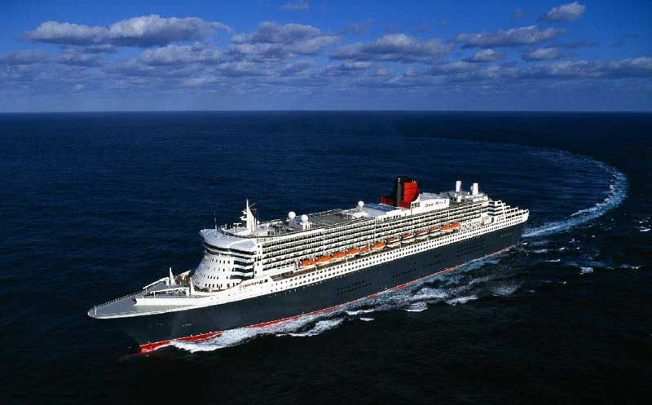
travelling by ship
Travelling by ship is also very popular now. It is very pleasant to feel the deck of the ship under the feet, to see the rise and fall of the waves, to feel the fresh sea wind blowing in the face and hear the cry of the seagulls.

Slide 9
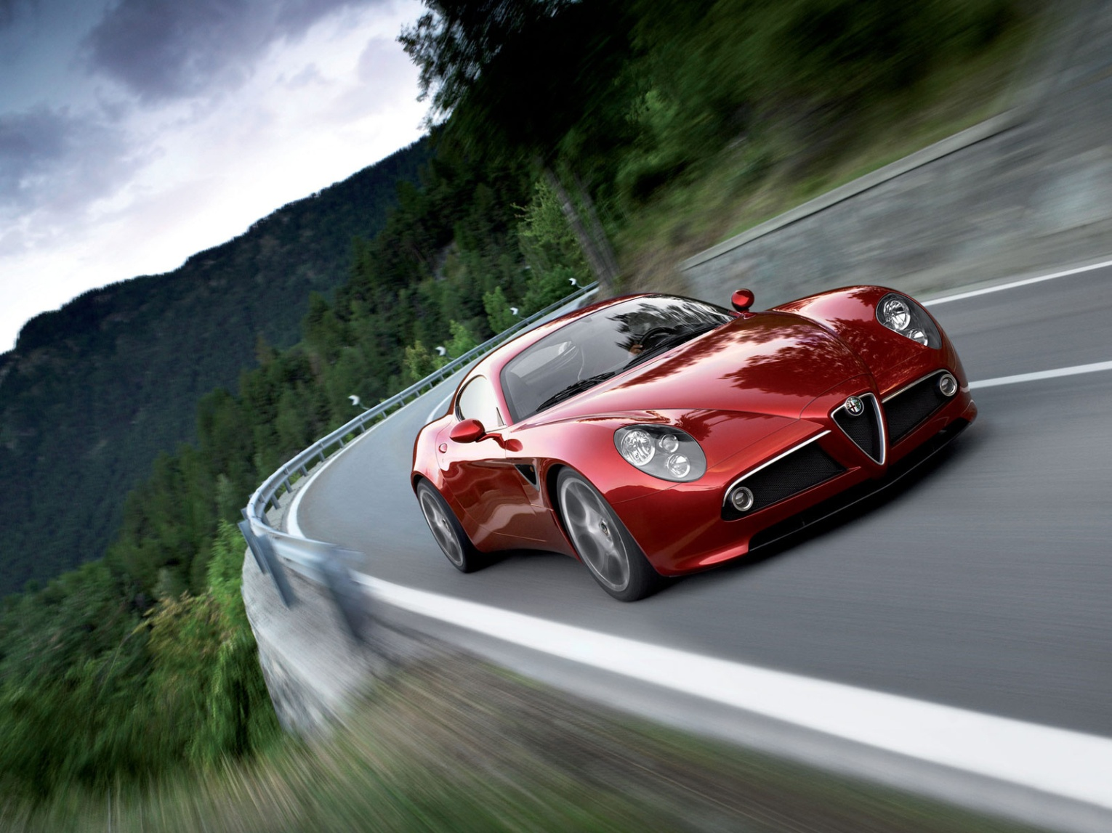
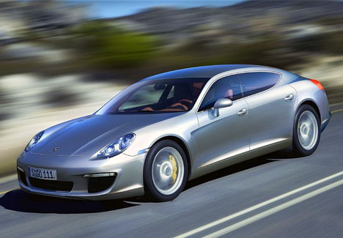
travelling by car
Many people like to traveling by car. It is interesting too, because you can see many filings in a short time, you can stop when and where you like, you do not have to buy tickets or carry your suitcases.

Slide 10
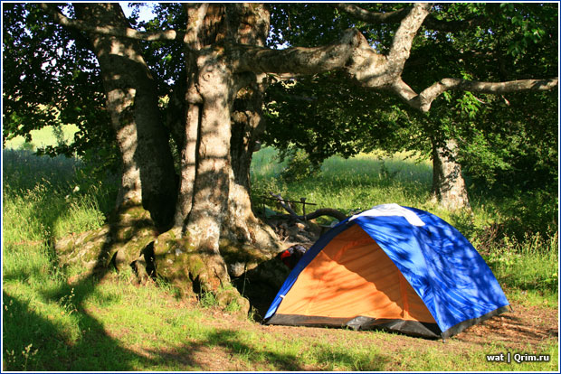

hiking and Hitch-hiking
A very popular method of travelling is hiking. It is travelling on foot. Walking tours are very interesting. Hitch-hiking is a very popular method of travelling among young people. But it is not so popular in our country as abroad.

Slide 11
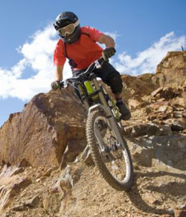
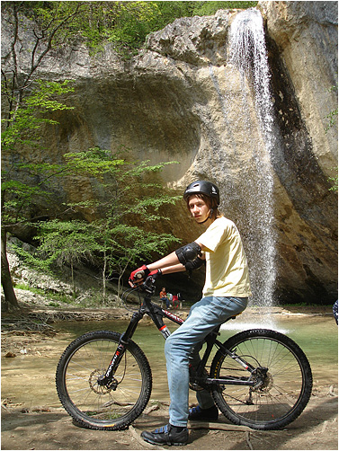
travelling by bicycle
Traveling by bicycle can be one of the most fulfilling ways to get from one place to another as it is healthy, stimulating, eco-friendly, and allows the traveler to experience more of the places that he/she travels through.

Slide 12

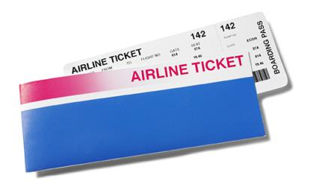
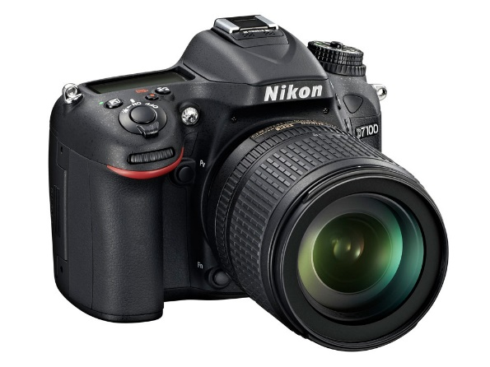
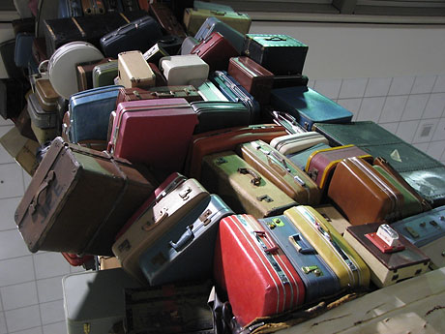

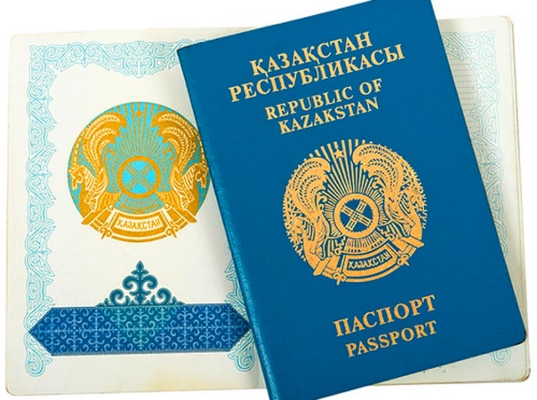

Necessary things for travelling

Slide 13
Match
There is no place, - home is best.
East or West, - its customs.
Dry bread at home is better, - like home.
Every country has, - than roast meat abroad.

Slide 14

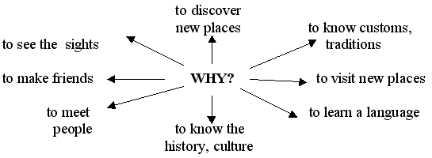

Slide 15
What is more pros or cons going abroad? Divide expressions into two groups.
discover new places,
miss your friends,
help to become more educated person,
improve knowledge of foreign language,
wait at airports,
depend on the weather,
have to think about accommodation and food,
broaden your mind,
many places are polluted,
teach people about art and culture,
the beauty of many places has disappeared,
help to relax,
beaches are always overcrowded,
the most fantastic place is home,
meet interesting people,
see world wonders

